Slide 1
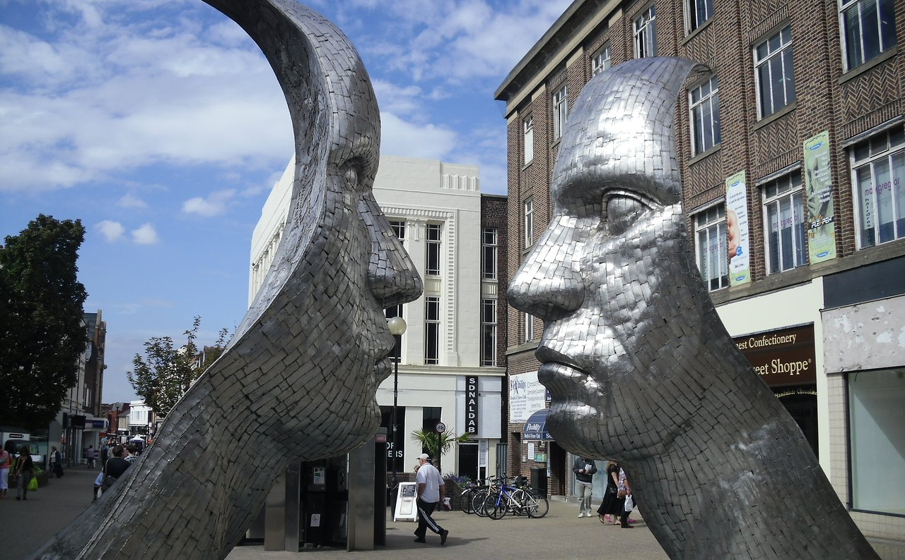

BedfordBID: April 2022 - March 2023
Private and Confidential
Andrew Dennison
Presented at AGM 16 October 2023
Notes:
I just want to run through a few extracts from the accounts…

Slide 2
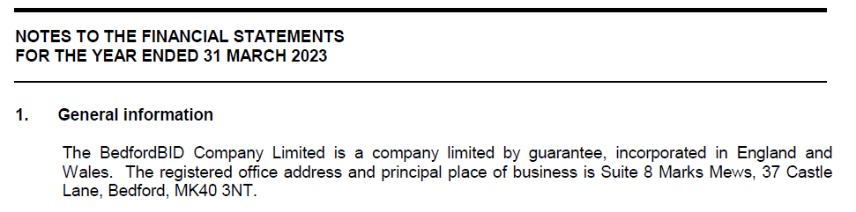
Status reminder
As a company limited by guarantee, there are no shareholders and cannot pay dividends.
Commonly used by not-for-profit organisations.
NB: The members are not the same as the levy-payers.
Notes:
Just a reminder to start with:
These accounts differ a little to the company accounts or the accounts you may be familiar with for tax returns at this time of year.
As a company limited by guarantee, the company cannot pay dividends out of the reported ‘profits’.
This is a form of company commonly used by not-for-profit organisations
Instead of shareholders the company has members.
The members are not the same as the levy-payers. Membership requires an application to be completed.

Slide 3
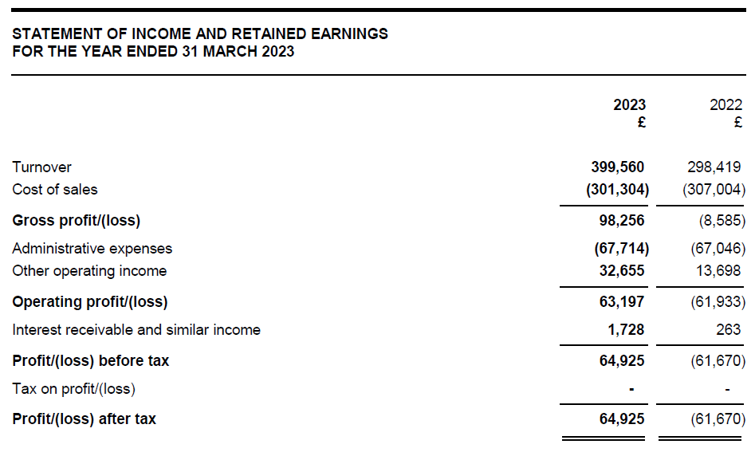
Terminology
Despite ‘profit/loss’ terminology used, per company legislation, it’s really income and expenditure with a surplus/deficit for year.
Notes:
Despite ‘profit/loss’ terminology required by company legislation, in reality it should be viewed income and expenditure with surplus/deficit for year.
Whilst income has fluctuated, due to recognition based on the timing of receipt, it is noticeable that expenditures has remained very consistent and reflects long term planning and management of resources to be able deliver consistent projects.

Slide 4
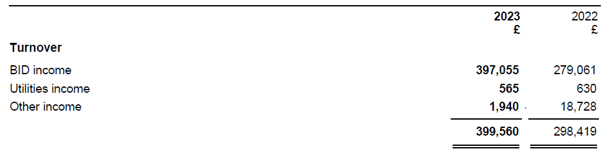
Income
The majority of income is the BID levy which is recognised upon collection by Bedford Borough Council.
Collections rates were slow in 2022 (reflecting deferred levies under COVID measures) resulting in unusually low income recognised in 2022 and a subsequent catch up during 2023.
Notes:
Income is recognised on a receipts basis and slow collection rates in 2022 (reflecting deferred levies under COVID measures) resulted in unusually low income recognized in 2022 and a catch up during 2023.

Slide 5
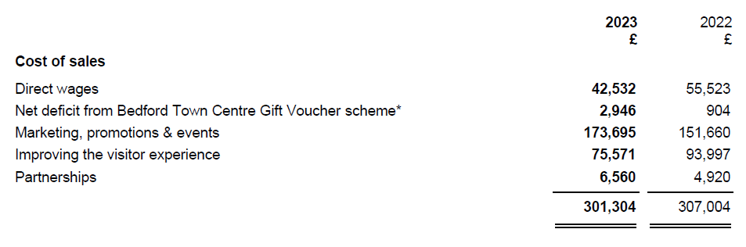
Project expenditure
Despite variations in the timing of income, project expenditure is carefully managed to provide a consistent delivery.
Costs overall are therefore very similar year on year.
Notes:
Very consistent

Slide 6
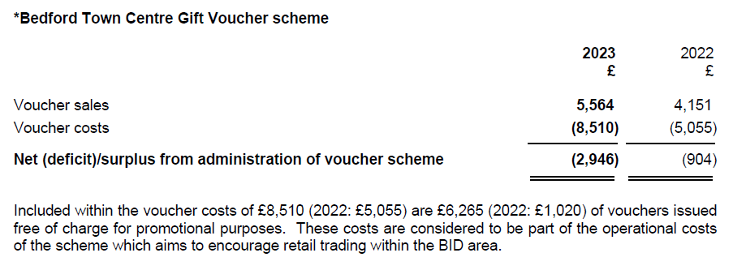
Vouchers
The voucher scheme continues to operate and, as per previous years, vouchers costs tend to be higher in years with a River Festival due to promotional issues.
Closing creditor £3,935 (2022: £3,500)

Slide 7
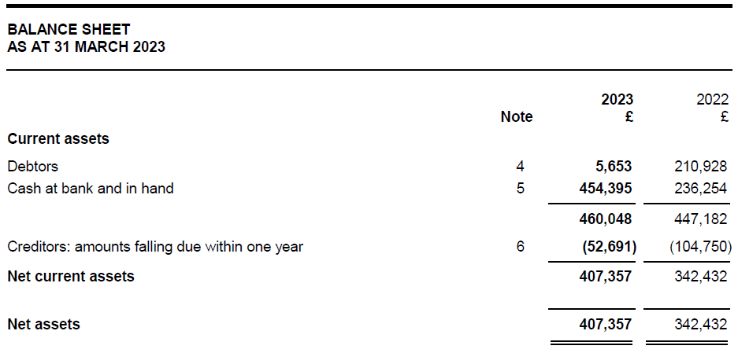
Cash basis
Day-to-day operations on cash basis.
Timing of levy receipts at the end of the year determine the level of cash held at the year end.
Notes:
Ultimately the year end balance sheet looks very strong.
Day-to-day operations are therefore run on a cash basis with expenditure not committed until cash is received.
At the year end there are therefore always reserves carried into the following year to cover scheduled costs (such as salaries) and in respect of planned project over the coming months.
This is a strength of the BID as it gives resilience for unforeseen events, such as the last year has brought.
Working only from funds received means the BID is working from a stable foundation but always cautious to make sure longer term planning is considered against immediate expenditure.

