Slide 1

BedfordBID breakfast 29th May 2019
GOOD MORNING
7.30am arrival and registration
7.50am Breakfast is served
8.10am BedfordBID Welcome
8.15am Presentations and guest speakers
Followed by open Q&A session & Networking
10.00am Close
Love Bedford is the marketing brand of Bedford Business Improvement District (BID) which promotes the interests of over 500 town centre businesses.

Slide 2



BedfordBID breakfast 29th May 2019
WELCOME – Guest speakers
BedfordBID update
Samantha Laycock, Chair
Transporting Bedford 2020
Bedford High Street update
Brian Hayward, Project Manager, Bedford Town Centre Transport Strategy
Social Media Masterclass
How Love Bedford can help your business
Ross Testa, Director

Slide 3


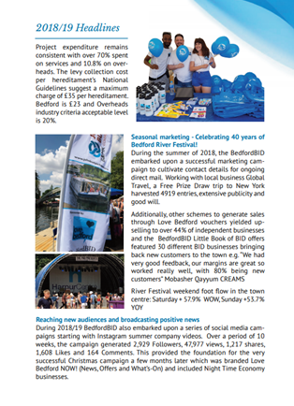
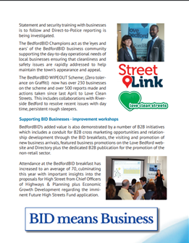
BedfordBID breakfast 29th May 2019
UPDATE: 2018/19 Annual Review
Annual Review document sent to all levy payers.
Online version available
www.lovebedford
in the downloads section.
Sample pages

Slide 4
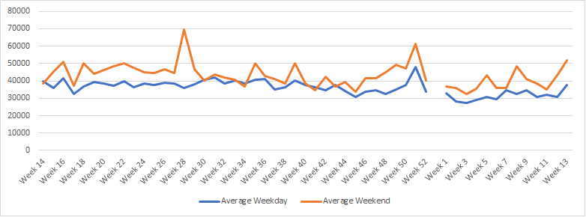
BedfordBID breakfast 29th May 2019
ANALYSIS: Foot flow 2018/19
2018/19 financial year Bedford -3.7% vs. -0.7% 2017/18 and 0.17% UK
Source of Statistics: The national high street index is collaboration between Springboard Research Ltd and the Association of Town Centre Management to deliver a national performance index based on footfall in town and city centres. Data for the High Street index has been gathered by Springboard from around 100 million pedestrian flows per month in around 140 UK towns and cities.

Slide 5
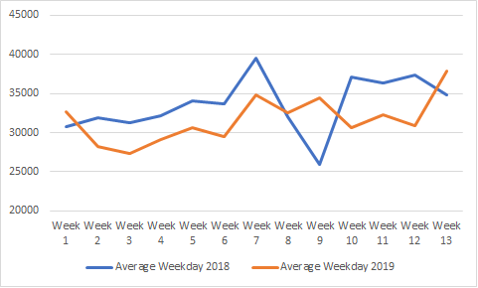
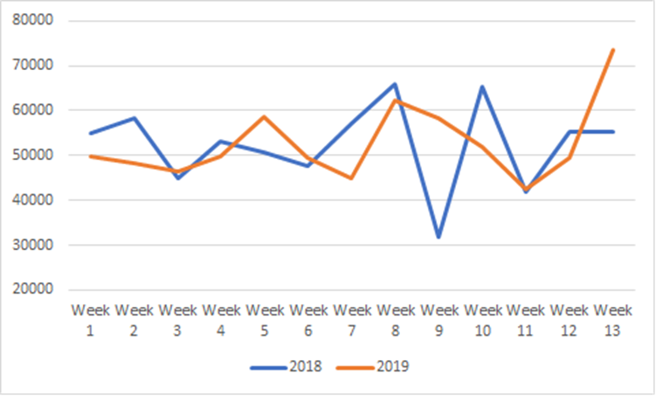
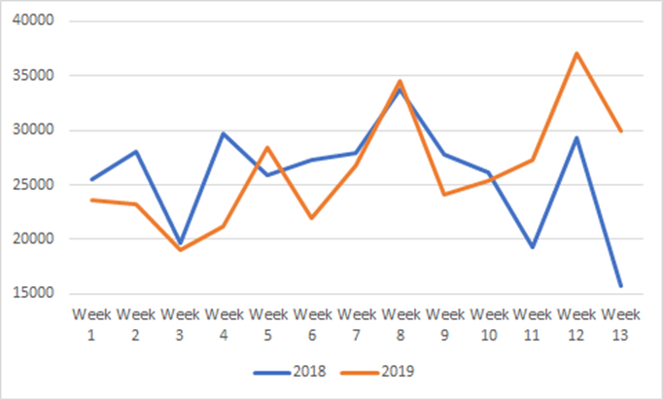
BedfordBID breakfast 29th May 2019
ANALYSIS: Foot flow 2018/19
Weekday performance is trending lower than last year on average.
 | Jan- Mar 2018 | Jan - Mar 2019 | YoY %
Monday | 399,068 | 414,256 | 3.8%
Tuesday | 413,470 | 373,240 | -9.7%
Wednesday | 447,984 | 415,884 | -7.2%
Thursday | 433,171 | 415,158 | -4.2%
Friday | 490,011 | 436,067 | -11.0%
Saturday | 682,306 | 685,292 | 0.4%
Sunday | 336,022 | 342,648 | 2.0%
Fridays appear to be consistently down throughout the year
only out performing 2018 in week 9 (Beast from the East ) in 2018 and week 13
Whilst Sunday’s despite a slow
start to the year,
have slowly begun
to outperform 2018
Source of Statistics: The national high street index is collaboration between Springboard Research Ltd and the Association of Town Centre Management to deliver a national performance index based on footfall in town and city centres. Data for the High Street index has been gathered by Springboard from around 100 million pedestrian flows per month in around 140 UK towns and cities.

Slide 6
BedfordBID breakfast 29th May 2019
UPDATE: “What’s the benefit, what does the BID do?”
For the investors in Riverside Bedford, the Bedford BID delivers on two essential elements.:-
Firstly, the BID creates a business community that together prioritises the support and promotes the change required to enable Bedford Town Centre to continue to adapt to the evolving demands of the retail and leisure sector. This in turn creates a supportive environment for the existing businesses and attracts new businesses.
Secondly, with shoppers looking to combine leisure to create days out, the role of the BID in marketing Bedford Town Centre as a vibrant destination with a wide range of retail, food and leisure offers is crucial to driving footfall and sales.
No ‘one hit wonder schemes’;
promoting and celebrating what’s good about the whole town.
Through the Love Bedford LBN! campaigns and business videos, businesses have been viewed, liked and shared by an average audience of
over 10,000 each week of dedicated followers.

Slide 7
BID 4 BALLOT - PROVISIONAL TIMETABLE 2019
Day of Ballot Thursday 17th October 2019
Proposed Date | Action | Relevant Regulation
Wednesday, 22 May | BID proposer notifies Council (Billing) and Secretary of State of intention to serve a notice to put BID proposals to ballot. | Regulation 3(2)
Wednesday, 14 August | BID proposer requests Council (Billing) to instruct Ballot Holder to hold BID ballot, with copy of BID proposals etc. (Any NNDR paper proposed to be affected can request a copy of proposals etc from this point.) | Regulation 4(2) and (3)
Thursday, 15 August | Council (Billing) instructs Ballot Holder to hold a BID ballot. | Regulation 5(1)
Thursday, 22 August | Council (Billing) notifies BID proposer of any conflict of BID proposals with published Council policy. | Regulation 4(4)
Thursday, 22 August | Council (Billing) provides BID proposer and, separately, Ballot Holder with names of NNDR payers affected, the address and rateable value of occupied hereditaments (or owned unoccupied premises). (Others can request to inspect this detail from this point.) | Regulation 11(1)
Thursday, 29 August (to ensure prior to latest date of Thursday, 5 September) | Ballot Holder publishes Notice of Ballot. Prepare a list of persons entitled to vote, send statement of arrangements for the ballot etc and send copy of Notice to Secretary of State. | Schedule 2 paragraph 3
Monday, 16 September (to ensure all delivered by Thursday, 19 September at the latest) | Despatch of Ballots to NNDR payers affected by the BID proposals | Schedule 2 paragraph 2(1)(b)
Thursday, 17 October | Day of the ballot. (5pm deadline for receipt of ballots) | Schedule 2 paragraph 2
Friday, 18 October | Ballot Holder counts ballots cast and declares the result | Schedule 2 paragraphs 14 and 17
Thursday, 17 April 2020 | Destruction of ballot papers from the BID ballot | Schedule 2 paragraph 19
Consultations until April/May
Draft Business Plan content May
Agree final content and produce June/July
Hard copy BP to levy payers and head offices plus and online business plan and FAQs August
Local Authority Executive Committee August/September

Slide 8
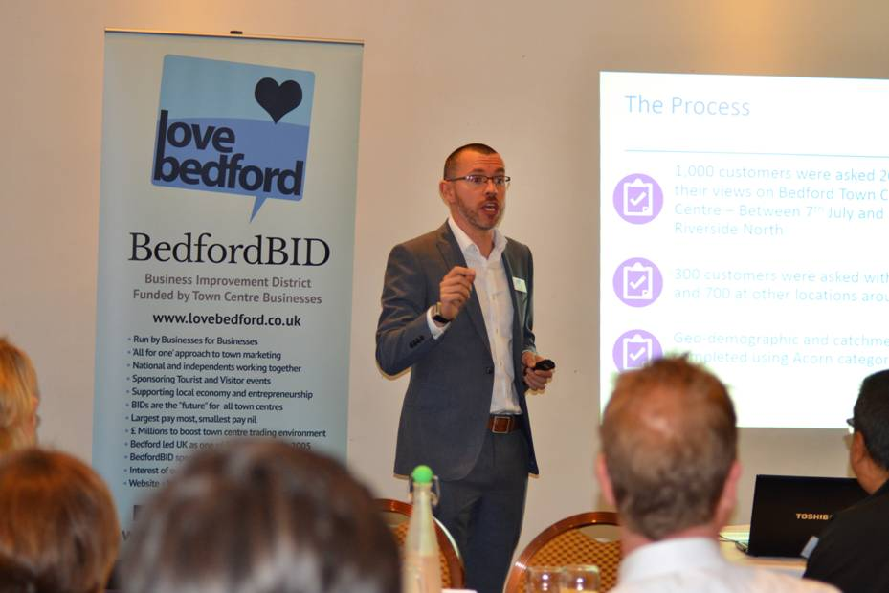


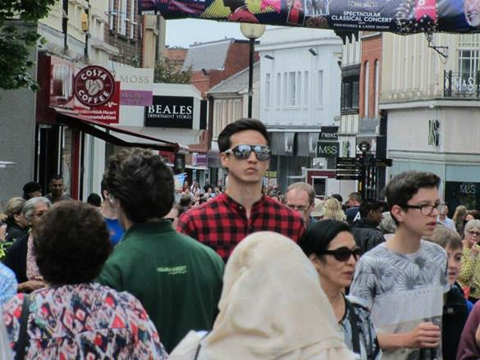
BedfordBID breakfast 29th May 2019
BID4: Have your say; PROCESS
Over the past 18+ months,
All BID businesses have had the opportunity to have
their say; contacted by independent, third party
electronically and/or telephone AND at BID networking
and briefing breakfasts face to face.
Customer surveys in all BID magazines; distribution £24k copies within 20 minutes
drive time of Bedford town centre
2000 intercept study interviews conducted in Bedford town
centre, the Harpur Centre and Riverside North May & Dec 2017
Bedford College student survey – Bedford town centre ;
face to face at their Open Day on 24th Aug and end of First
Impressions survey October 2017; 763 responses
Future High Streets Fund submission/visioning

Slide 9


BedfordBID breakfast 29th May 2019
BID4: Have your say; YOU SAID
BID Businesses…
Fill empty shops
Independent retailers need support
More advertising and promotion of the town
Need vibrancy
Too many homeless
Parking too expensive
Not sure what difference BedfordBID is making, need facts and figures
It's an additional expense on top of business rates can’t afford to pay in advance and quite high.
It's nice to have someone like Love Bedford working on behalf of the town.
Recently joined voucher scheme. Working well and hope it continues.
Exclusion scheme and app. works.
The police aren't very helpful when there is an issue, and take ages to come out. The Bedford Bid people are excellent. I phoned for assistance, and someone came out to help me right away when I had shoplifters
BID proactive. I can't attend things.
BID come round to store, good, working hard.
Value for £. Need to know more about what we get?

Slide 10

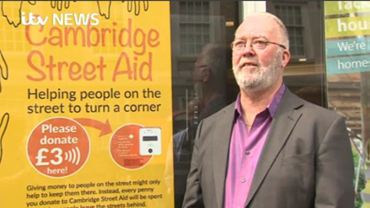
BedfordBID breakfast 29th May 2019
BID4: Have your say; YOU SAID
Businesses top priorities
Safety
Marketing & Promotion
/footfall
Parking too expensive
Homelessness
Cleanliness
Empty shops
contactless terminal(s)

Slide 11
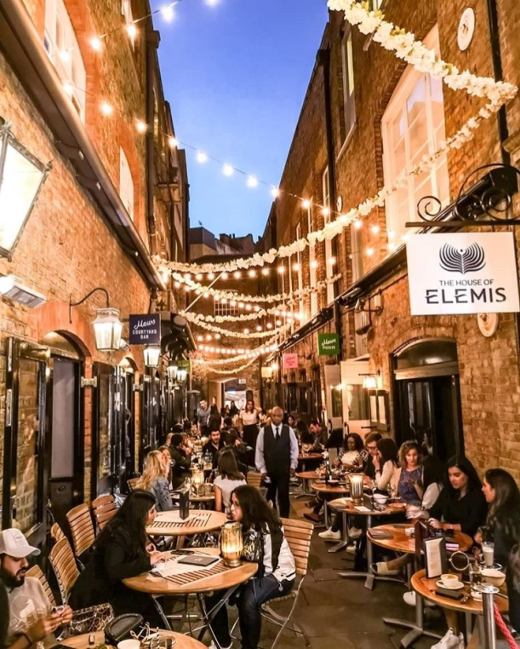
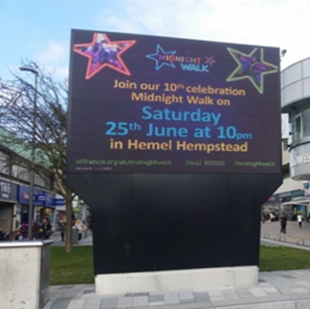
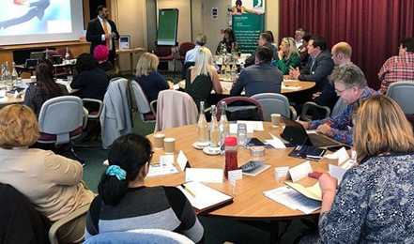
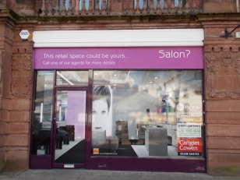
BedfordBID breakfast 29th May 2019
BID4: Have your say; OUR RESPONSE
BID4 key themes …
Clean, Safe & Welcoming
Love Bedford; celebrating what’s
good about the whole town. Festivals,
promotions, trails plus highlighting
independent businesses
3. Supporting businesses.
4. Measurement & Reporting
Empty shops – revisit the 2017 Intercept study list of desired businesses and develop a plan to target!
ShopJacket, Jackets for empty units
BID levy money is ring-fenced for use only in the BID area.
BIDs cannot subsidise local authority statutory obligations, however BIDs can enhance services.

Slide 12
BedfordBID breakfast 29th May 2019
BID4: OUR RESPONSE
We will also …
Work harder to engage and update businesses with BID’s performance stats and facts
Communicate better how best to get involved i.e. promotions and process for joining the Board of Directors
From April 2020 increase the BID levy exemption threshold from properties with RV of £8,100 to £12,000 in line with Small Business Rates Relief
From April 2020 introduce two stage payments for properties with RV between £12,000 and £14,750
Offer Voluntary Membership outside BID zone to generate additional revenue whilst helping to address those issues impacting upon town centre from areas such as Midland Road East

Slide 13
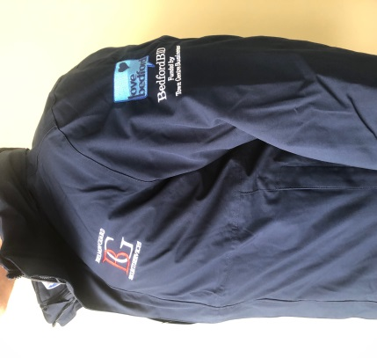

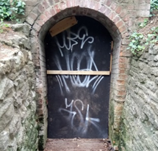
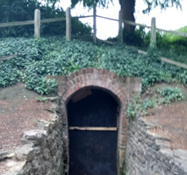
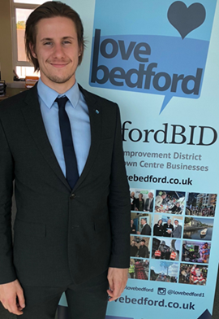

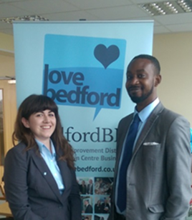



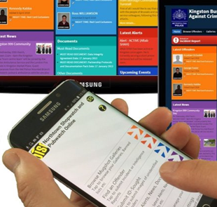





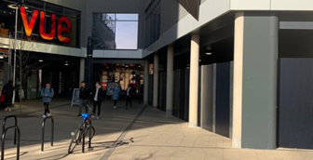


BedfordBID breakfast 29th May 2019
BID4: Clean, Safe & Welcoming
BID
Night
team
Voucher redemptions
Reporting graffiti, rubbish, spillages, vomit, dog fouling
WipeOUT (zero tolerance on graffiti) reporting
StreetLink, homelessness support signposting and reports
Continue to handle service requests from RetailRadioLink users
Highways pavements and drainage
Monitoring ‘professional beggars’ and rough sleepers, working
with agencies to build intelligence and support
Reuniting lost children, elderly and the vulnerable
Being informed with opening and closing of businesses, making new
visits/introducing BID schemes and services.

Slide 14



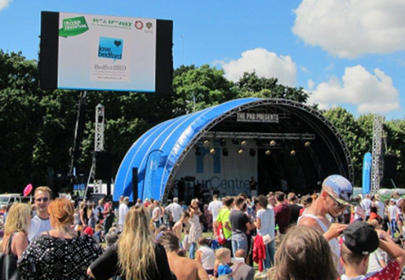
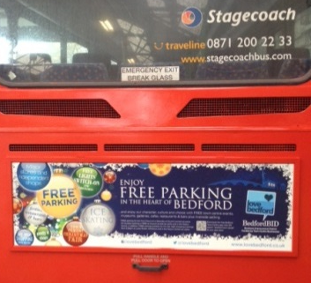

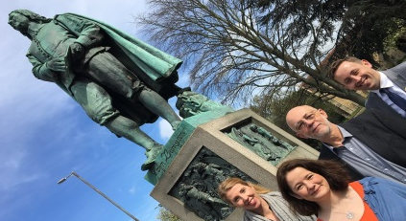
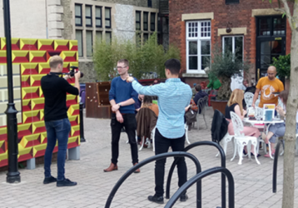
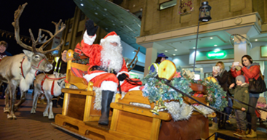
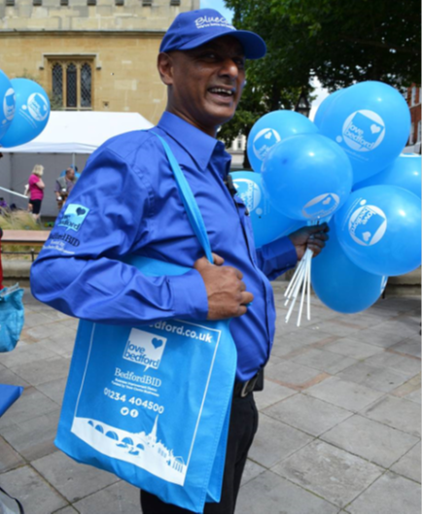

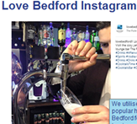



BID4: Love Bedford; creating a vibrant destination, promoting and celebrating what’s unique about the town
Love Bedford is the customer-facing brand which supports town centre businesses large and small, retail, services and experiences.
www.lovebedford.co.uk the ‘go to’ site for all the latest information and regular updates about
the town, businesses, events and offers.
- Love Bedford NOW! News, Offers and What’s On; over 500 scripts
last Christmas together with a variety of dedicated sector videos
to add positivity to both businesses and visitors to our town.
- Compelling reasons to visit the town; events, offers , promotions and
what’s new
- Business branded broadcast e-shots every month
- Direct mail e-shots to consumers every month
- Door to door BID magazines c24k distribution every quarter
- Regional radio throughout the year
- Seasonal marketing; outdoor; buses and railway station sites
- Social media Facebook , Instagram and Twitter a/cs
- Events & Festivals - Love Bedford Day (weekend!), pre-Christmas lights
switch on and annual fireworks display sponsorship
- Town centre trails including food
- Bedford College Brooks Hair & Beauty Show support
- Hard copy Beds Local, Bedford Bulletin, Kempston Calling,
- In & Around, Guided Walks, Country Life (Regatta)
- Cultivating a database through competitions and FREE prize draws.
Through the Love Bedford LBN! scripts and videos, businesses have been viewed, linked and
shared by an average of over 10,000 dedicated followers each week.

Slide 15

BedfordBID breakfast 29th May 2019
BID4: Supporting businesses
Having an attractive town centre as well as a critical mass of retailing and entertainment, is an important element needed to retain and attract new employers plus employment to a town. The BedfordBID Champions street team; around the clock Sunday – Monday presence working closely with the Council’s Enforcement team, Harpur Centre Security, town centre business’ security, Bedfordshire Police and CCTV are also working to help keep the town safe, clean and offer a friendly welcome.
Local influence. Representing a voice for businesses including planning applications, street vending and lobbying.
Day to day support on the challenges businesses face, conduit for business support ,help and contacts.
Forums to meet BID Directors to raise issues.
Networking and bespoke training events including , customer experience, visual display and social media and BIIAB Level 2 Award for Personal Licence Holders
Steadily saving businesses equivalent to their BID levy through local partner Utilitrack with free utility cost evaluation service
The evening economy sector BedSafe is now administered by BedfordBID.
Business awards to recognise and reward excellence within our business community.
Representation at national networks including BritishBIDs , ATCM best practices annual surveys, RRL&E industry audits/accreditations.

Slide 16
BedfordBID breakfast 29th May 2019
BID4: Measurement & Reporting
EVALUATING & REPORTING:
Over the next five years we will enhance our communication, transparency and accountability.
We will
- continue to evaluate all of our work
- provide details of all key activities, insights and learning,
- demonstrate a return on investment
- work with BritishBIDs and their Nationwide BID Survey (which is now welcomed by policy makers and businesses alike) as an essential resource in charting the development and evaluation of the BID industry
We will
- set clear financial and operational objectives,
- monitor and review performance
- deliver against given objectives and desired outcomes to a high standard
- review KPIs to include industry best practice standards
- investigate British BIDs Accreditation to ensure our quality management systems are robust
- provide annual reporting of the main sections of the Business Plan activities and results using the RAG scorecard rating system (red, amber or green) to provide BID businesses with a simple and accessible way to evaluate our performance against:-
- Agreed KPIs and financial statements
- Nationwide BID Survey
- New investment in the area and new businesses activity
- Business feedback and satisfaction survey
- Consumer perception and behaviour surveys
- Numbers of issues reported and sorted by BedfordBID within set timescales
- Extent of cost saving initiatives offered
Benchmarking – Between April and June 2022 to complete questionnaire amongst all levy payers
Establish KPIs by March 2020 – retail, non retail, day and night time economy.

Slide 17
BedfordBID breakfast 29th May 2019
BID4: Measurement & Reporting
Foot flow. Using the industry standards of Springboard Ltd we will measure like for like year on year, month on month and week on week performance of Bedford against the region and nationally.
Vacancy rates – Springboard Ltd , Churn and 3 year barometer
Catchment penetration - It is generally recognised that it costs more to acquire a new customer than it does to keep an existing one.
Return on Investment for advertising, PR and sponsorship arrangements.
On line and off line media advertising will be analysed by ability to reach the highest possible percentage of the target audience with minimum costs and minimum waste; A PR strategy will be devised charged with objectives to include:-
- Creating and maintaining the Love Bedford brand image
- Awards and sponsorship to benefit town centre businesses
- Disseminate information to the public
- Damage limitation to overcome poor publicity
- Forge stronger, lasting customer relationships.
The PR campaign will be co-ordinated with the advertising campaign to maximise exposure and coverage and include opportunities for BedfordBID to engage with community. Monthly media briefings will be considered.
Sponsorship applications will be decided upon a given criteria including:-
- benefits to the BID zone businesses
- agreement to provide an evaluation report detailing the benefits received
- Love Bedford brand exposure activity during the period of sponsorship,
- details of how the event will be measured in terms of media coverage or counting the attendance
- data capture arrangements and opportunities for use by BedfordBID
- Report on both positive and negative outcomes as a result of the sponsorship.

Slide 18
BedfordBID breakfast 29th May 2019
BID4: Measurement & Reporting
Web site - unique visits, dedicated pages, most/least popular, data capture, directory searches and feedback
Expansion of online marketing channels - CRM; data capture, industry benchmarking returns
Sale of Love Bedford gift vouchers, growth and redemption levels not to fall below 90%
Added Value, Customer experience
Exit surveys and field research repeat, CTAG crime stats
Customer and business engagement
Frequency and attendance at meetings – retailer and district sectors, Steering Group , Retail RadioLink and BeBAC
Number of businesses attending B2B Breakfasts
BedfordBID Champion’s visits
Business survey and response levels
Levy collection rate / Levy collection charge / Overheads
Collection In line with budget, no less than 96%
BritishBIDs benchmarking; Industry Criteria acceptable levels .
Additional income
As budgeted for sponsorship, Affiliate Membership
Staff retention and sickness levels
Turnover rates and industry standards, average 4.5 days a year
Board members attendance rates
Operating costs & % on training
ON SITE INTELLIGENCE
Continue to measure footfall but further develop our partnerships with the Harpur and Howard Centres to ensure we have a full understanding of how the town is performing. We will also continue with exit surveys as well as a follow up to the field research undertaken in 2012.

Slide 19

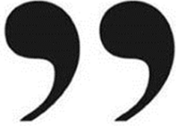
BedfordBID breakfast 29th May 2019
BID4: Have your say; General Public
Public responses to What do you believe are the most important aspects of an attractive town centre and why? Conveniently summarised with the mnemonic CUSTOM.
Clean - streets with no litter, spilled food or dirty pavements. Effective punishment / fines for those who litter. Showing pride in our town.
Up-to-date - a sponsored screen which local retailers can post ‘deal of the day’, special offers and other incentives. Helping shoppers find great deals and informing them of current news from retailers and forthcoming events.
Safe / Secure - zero tolerance on antisocial behaviour, with visible security personnel. Helping visitors feel relaxed and reassured.
Thriving - real opportunities for small or start-up businesses in empty retail spaces at reduced rent to help them establish. Showing our town as a positive place to set up and run a business.
Open / accessible - considerate to all abilities to access without problems. Showing that our town is a welcoming environment and helping those less able to get around.
Maintained - fast identification and marking for repair of damaged or uneven paving and street furniture. Well-tended garden areas. Gives a positive outlook for our town. It shows we care.
…plus … A bus to get into town on a Sunday please …

Slide 20

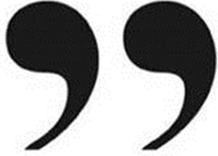
BedfordBID breakfast 29th May 2019
BID4: Have your say; ‘YOOF’
1 ‐ More shops for younger people, H&M, workwear shops, Zara, Hollister
2 ‐ More frequent (inc later), lower fares (student discount) , improved congestion
cleaner buses, improved bus system/journey, better transport links (more areas)
3 ‐ Arcade, bowling, football/basketball pitch, skate park, youth club, gym, cinema
BMX Track, more for young people to socialise, pool hall, cinema Disney Store
4 ‐ Five Guys, Pret, Starbucks
5 ‐ Art Exhibits, more fairs, music, community events
6 ‐ Gucci
7 ‐ Comics, skates, health, pets, gaming/tech shops, sports shops
8 ‐ Nike, Footlocker
9 ‐ Lush, Mac
10 ‐ Pop Up, themed
Student survey 2017
1. Different/more shops
2. Better (public) transport/travel
3. More attractions/leisure
4. Different/more restaurants
5. More events/entertainment
6. More designer shops
7. Different/more leisure shops
8. Different/more shoe shops
9. Different/more health/beauty
10. Better Market and New format, flagship stores

Slide 21

BedfordBID breakfast 29th May 2019
BID4 Consultation: HAVE YOUR SAY
If you still feel you want to share your views, we will continue to accept your feedback.
Contact:
Graham Hill 07990 990252
graham.hill@insight6.com

Slide 22
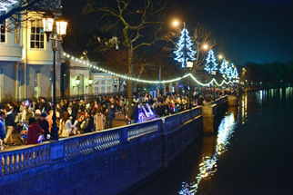

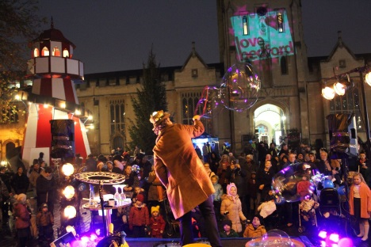





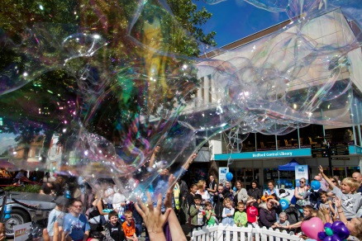
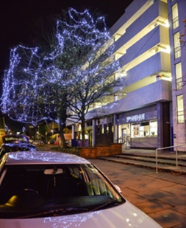
BedfordBID breakfast 29th May 2019
DATES FOR YOUR DIARY
Check out Brooks (Bedford College) Hair & Beauty Show,
Food & Drink magazine delivery 26th June
In & Around Bedford glossy magazine DPS BID feature
Guided Walks 2019 around Bedford publication
Retail RadioLink & Exclusion Scheme meeting – Look Out for details
BedSafe meeting 12th June
Bedford BID board meeting 9th July
Bedfringe 15th – 27th July
Little Italy Food Fest Sunday 21st July
StrEAT Feast 26th July
Love Bedford Day Medieval Festival 27th & 28th July
Bedford Christmas Fair 23rd & 24th November, culminating with town
centre lights Switch-on and fireworks @ 5pm on Sunday 24th Nov.
Pick up your 2019/20 planner here TODAY!
NEW DATE AND TIME for the BedfordBID Board and ‘open’ meetings
TUESDAYS @ 10.00am at Bedford Swan Hotel

Slide 23
BedfordBID breakfast 29th May 2019
BedfordBID; No one hit wonder schemes
BedfordBID was one of the first Business Improvement Districts (BIDs) to form in 2005; over 14 years in operation. This successful model is now used across the country in over 300 BIDS nationwide.
Utilitrack - £62,408, an average of £12,481 over the past five years businesses have saved in utility costs.
Town centre vouchers – over £1m of redemptions, 290 participating businesses of which over 70% are independent with overall 90% redemption rate.
Love Bedford website – relaunched in 2012, attracting over 100k unique visitors every year providing an online presence for every BID business. Average of 24,536 online directory searches a year.
Love Bedford NOW! News, Offers and What's On reaches a guaranteed 10,000 followers each week for all businesses – non retail, leisure, heritage, entertainment and culture.
Retail RadioLink & Exclusion scheme - 253 members
350 additional members participating in the recently launched BeBAC (BedfordBID Businesses Against Crime) initiative plus ALL evening economy BedSafe businesses which provides a community network for crime prevention and evidence based reporting for prosecutions.
223 premises signed up to WipeOut , imposing zero tolerance to graffiti
ChildSafe and safely reuniting the elderly and vulnerable
BID ‘street team’ BID Champions – eyes and ears, Monday to Sunday, Clean streets and StreetLink reporting every day . Connected to CCTV and Bedfordshire Police. Visiting businesses every day.
Taxi Marshalls now remodelled into the Bedford BID night team
Over £60k invested in town centre Christmas lighting enhancements, sponsorship of annual firework display.
Networking and training with quarterly briefing breakfast attended by regularly 50+ businesses, training and mentoring programmes plus mystery shops and customer experience advice for an average of 30 businesses each session
2018/19 - 198,029 direct mail e-shots delivered ; 69 multi-branded business e-shots delivered
Cultivating a database for direct marketing , over 5000 respondents to the NY Free Prize Draw ………….

Slide 24


BedfordBID breakfast 29th May 2019
HOW TO CONTACT US
www.lovebedford.co.uk
info@lovebedford.co.uk
01234 404500
BedfordBID Champions ‘on the streets’

